Slide 1
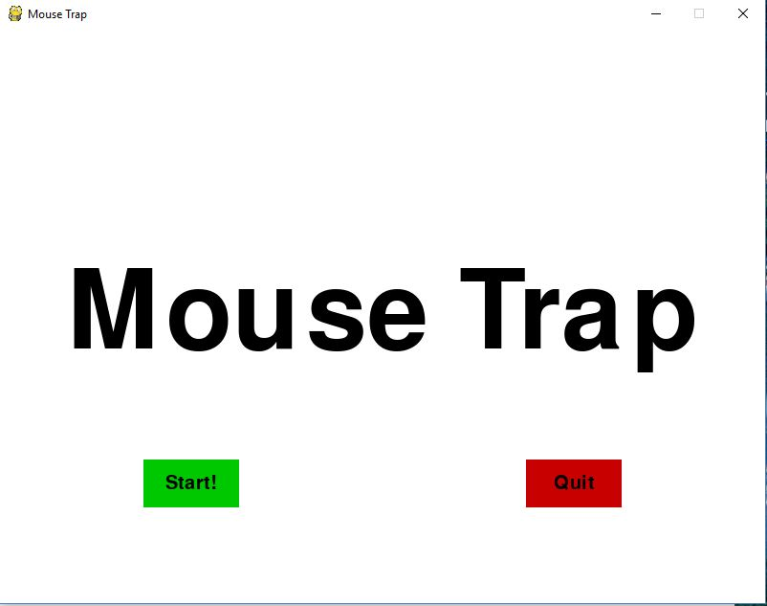
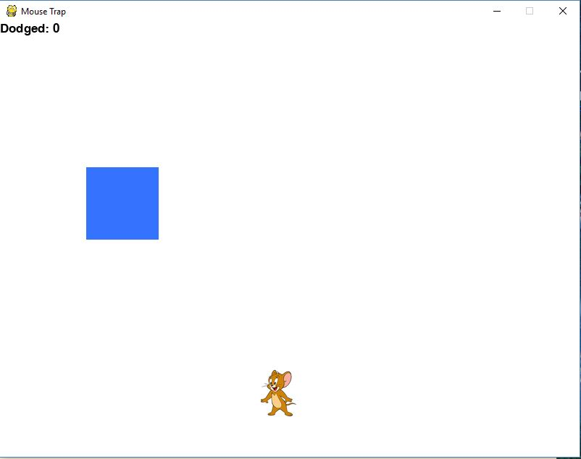
Mouse Trap (A dodging game)
By: Matt Jones

